Slide 1
Case Study 5:
Pie Alternatives
Raghav Arora, Alex Gadea, Madeline Willett
2/27/23
Notes:
Introduction:
Hi we are team 5 comprised of Raghav, Alex and Maddie.
Our group was assigned case study 5
In the following presentation we will go over this case study and analyze its contents
The goal of the presentation is to decide which graphic is the most effective in showing the results of the case study.
In doing so we will be analyzing all the graphs and their alternatives, showing how these graphs are converted to new graphs and providing suggestions on how to improve these new graphs.

Slide 2
Case Study 5: Summary
Students had a negative perception of science
100 student survey was conducted
Effect of summer camp on students interest in science
Result
70% of students were interested after program
Notes:
Case study 5 talks about how a the science department of an elementary school created a summer pilot program to improve the perception that younger students had about science. Previously, incoming fourth graders had the perception that science was difficult and that they wouldn't like it, so the science department conducted a study on 100 second and third graders before and after the pilot program, and found that the program was able to positively influence students viewpoints on science. Before the program, 40% of students felt “OK” about science and after the program, 70% of students expressed some level of interest, saying that they were either kind of interested or excited. Within the case study, a pie chart was made to depict this interesting statistic. We will now analyze this pie chart as well as the 4 alternative graphs.

Slide 3
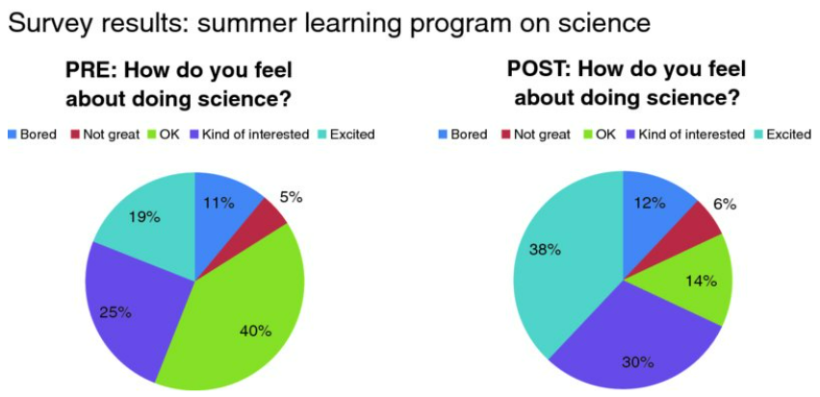
Pie Chart- Overview
Cognitive Load
Clutter
Non- Colorblind friendly colors
Lack of visual hierarchy
Notes:
This pie chart creates cognitive load because it forces the viewer to look back and forth at the graphs to discern what changed between the PRE and POST. There is unnecessary clutter on this visual as the same legend is repeated twice and the same question “How do you feel about doing science?” is repeated twice. Some of the colors used in the chart are not colorblind friendly. These colors include green and red. Finally, there is a lack of visual hierarchy within the colors.

Slide 4
Pie Chart: Improvement Suggestions
Single legend
Replace Red and Green Colors
Create a Visual Hierarchy
Notes:
Although two pie charts are not really effective an effective way of conveying the information, there are a couple suggestions to at least make the graph more visually appealing. For example, there should just be one legend for both charts and the titles of the charts can just be PRE and POST with the question stated at the top of the visual. Also, the green and red should be replaced by colors that are more colorblind friendly such as grey or orange. Finally, the colors around the pie chart should go from darkest to lightest (or vis versa) to help create the visual hierarchy going from bored to excited.

Slide 5
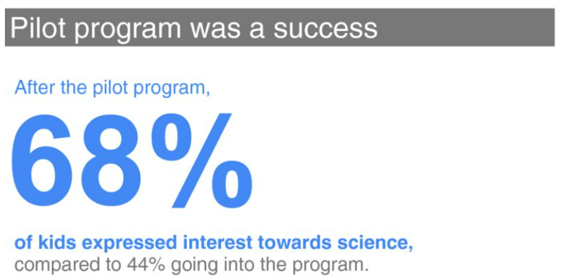
Alternative 1: Show Numbers Directly
Simple
Visual Hierarchy
In Text Color, Bold, and Size
Good use of the color ‘blue’
Visual title presents conclusion
Notes:
Alternative 1 is to show the numbers directly. This visual is very simple and direct to the point. There is a visual hierarchy, making the important number and key takeaway big and in blue, while the before number is smaller and in grey. It also uses the preattentive attribute in text color, bold, and size.The use of blue is colorblind friendly. In addition, the conclusion of the visual is stated as the title

Slide 6
Changes from Pie Chart to Showing Numbers
Notes:
Graph has been transformed from Pie Chart to Showing numbers
The title has been changed to convey the big idea immediately
The legend has been removed
The text has been converted from a question to a statistical statement
The actual chart and all its aesthetics have been dropped for a number that is a percentage

Slide 7
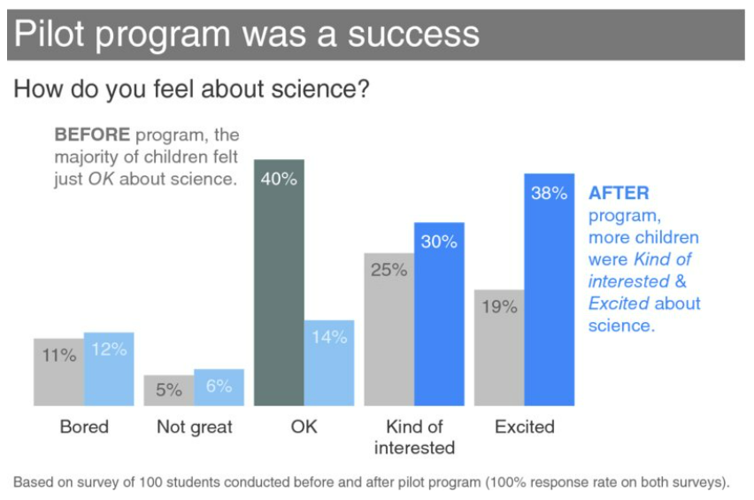
Alternative 2: Bar Plot
Easy comparison (Proximity)
In text Color and Bold
Graph title presents conclusion
Good use of ‘blue’
Main idea pushed to foreground
x-axis omitted
Notes:
Alternative 2 is a simple Bar Plot. This plot reduces cognitive load because it makes comparison to the before and after easy to understand since the bars are right next to each other. This is using the Gestalt principle of proximity. It also uses the preattentive attribute in text color and bold for the conclusions. The conclusion the audience is supposed to gain from the visual is the title of the plot, also reducing cognitive load since the viewer doesn’t have to think about what they’re supposed to conclude. The plot has a good use of the color blue, which is a colorblind friendly color. Color was also used in a way to push the important information to the front (the darker blues and greys) and the other information to the back (the lighter blues and greys). The x-axis was omitted and the bars were labeled directly.

Slide 8
Changes from Pie Chart to Bar Plot
Notes:
Graph has been transformed from a pie chart to a bar chart
The sections of the pie have been converted to side by side bars
The percents on the pie chart sections are now on the bars
The two legends on the pie have been converted into one legend on the x axis
The color has been changed from multiple colors to hues of grey and blue for consistency.
The title has been changed to reflect the results
The pre/post questions on the pie chart have been changed from 2 questions to 1 question
Before and after text has been added to the bar chart

Slide 9
Barplot: Improvement Suggestions
Less literature
Less color
More consistent color
Notes:
Add a legend to show that grey represents before, and blue represents after, rather than having the descriptions which just incleas cluttert. Keep the colors consistent, for example there is no need to highlight the blue bar in “kind of interested”. Brings attention to a point that we don’t necessarily need to portray.

Slide 10
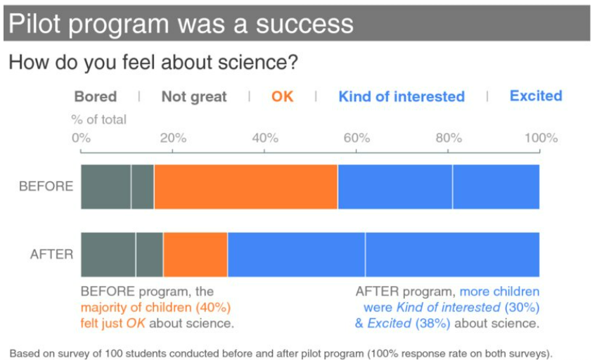
Alternative 3: 100% Stacked Horizontal Bar Plot
In Text Color
Part-to-whole concept
Easy comparison
Good use of the colors ‘blue’ and ‘orange’
Graph title presents conclusion
Notes:
Alternative 3 is a 100% stacked horizontal bar plot. It uses the preattentive attribute in text color for the conclusions on the bottom.This plot is useful in displaying the part-to-whole concept. This type of plot allows for easy comparison among each section and among the Before and After bars. The visual has a good use of the colorblind friendly colors blue and orange, within both the bars and the textboxes, highlighting the important takeaways. The title of the plot tells the audience what they are supposed to conclude from the visual, reducing cognitive load.

Slide 11
Changes from Pie Chart to Stacked Horizontal Bar Plot
Notes:
Graph has been transformed from a pie chart to a stacked horizontal bar chart
The sections of the pie have been converted to sections on the stacked bars
The percents on the pie chart sections are now represented on the x axis on top of the chart
The two legends on the pie have been converted into one legend on the x axis that is color coded to the section on the bars
The color has been changed from multiple colors to grey, orange and blue for consistency.
The title has been changed to reflect the results
The pre/post questions on the pie chart have been changed from 2 questions to 1 question
Before and after text has been added to the stacked horizontal bar chart

Slide 12
Stacked Horizontal Bar Plot: Improvement Suggestions
Less literature
Visual hierarchy is difficult to determine
Notes:
Not necessary to include the Before statement and after statements because the audience can see it visually, and it makes the visual hierarchy hard to determine with all the clutter.

Slide 13
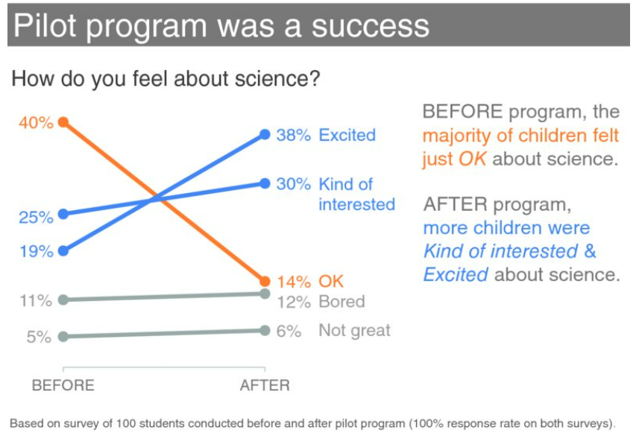
Alternative 4: Slopegraph
Continuity and Connection
In Text Color
Visual hierarchy
Easy Comparison
Good use of the colors ‘blue’ and ‘orange’
Graph title presents conclusion
Notes:
Alternative 4 is a slopegraph. This plot uses the Gestalt principles continuity and connection. It also uses the preattentive attribute in text color for the conclusions on the right. There is a clear visual ordering from greatest to least, creating a visual hierarchy. This type of plot also allows for easy comparison between the before and after, as we can quickly see which how much each category increased or decreased. This plot makes good use of the colorblind colors blue and orange. Once again, the title of the plot is the conclusion we want the audience to take away from the visual.

Slide 14
Changes from Pie Chart to Slopegraph
Notes:
Graph has been transformed from a pie chart to a slopegraph
Change from the pilot program is now represented via the y axis through before and after percentages
The sections of the pie have been converted to lines on the slope graph
The percents on the pie chart sections are now on the y axis of the slopegraph
The two legends on the pie have been converted into one legend on the y axis. It is also color coded to the lines of the slopegraph
The color has been changed from multiple colors to grey, orange and blue for consistency.
The title has been changed to reflect the results
The pre/post questions on the pie chart have been changed from 2 questions to 1 question
Before and after text has been added to the slopegraph

Slide 15
Slopegraph: Improvement Suggestions
Less Literature
Notes:
As for this slope graph, there is not much improvements to make apart from maybe taking the text on the right side out of the graph. What is said in the text is already implied in the graph, and the x axis already shows that the left side represents student feelings before the pilot program and the right represents the feelings after the program

Slide 16
Conclusion
Showing numbers is the best
Simplest way to present conclusion
Avoids visual and data clutter
Clear and concise
Notes:
We believe the best graphic to represent the results of the pilot program is just simply showing the numbers. This is because this graphic is clear and concise and presents the results of the program in the most effective way. The graphic avoids clutter and other disinteresting observations. It is focused and to the point and uses the preattentive attributes of bold, color and size really well. Moreover, it also uses visual hierarchy well to show the big idea and key takeaway immediately.

